Slide 1
Making A Farm Visit
Hints and Strategies
2019 Midwest Regional Dairy Challenge
HCC, IL February 14, 2019
Mike Hutjens
Professor of Animal Sciences Emeritus

Slide 2
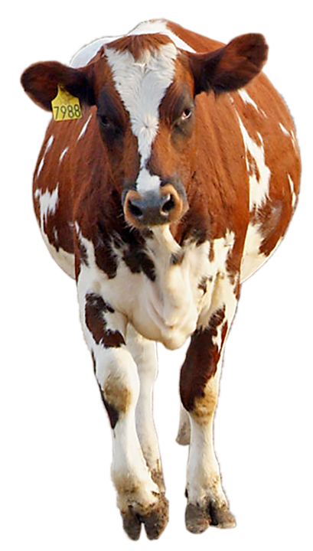
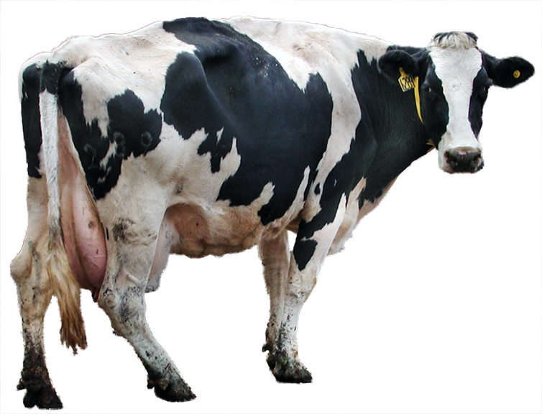
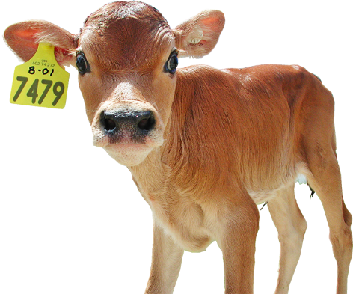
Today’s Changing Economics
Close up heifers
< $1,200+
Wisconsin costs to raise
a heifer is $2,000
Cull cows at
40 to 62 ¢/lb
Bull calves worth $50
Heifer calves are lower

Slide 3
Changing Dairy Economics
Milk Economics (Dec, 2018)
Class III milk price: $13.28/cwt
Milk fat value: $2.51/lb
Milk protein value: $1.14/lb
Milk quota and milk base are here

Slide 4

Classification of Today’s Dairy Farms
We will survive.
We are using up our equity;
need to stop the bleeding.
We cannot get out,
I am not giving the cows away
Will the banker extend
more line of credit?
We will sell period

Slide 5
Making a Farm Visit—Who Arranges?
Individual farmer
Local veterinarian
Feed company/cooperative
Consultant
Extension
Bottom line: Another set of eyes

Slide 6
Making The Farm Visit—Why?
Ask the reason why you are invited
A clearly defined problem
Need to improve production/components
Desire to increase profits
Ask each person involved: farmer, veterinarian, feed company, extension advisor, spouse, etc.

Slide 7



Goals for the Farm
Is the farm positioned to compete with the current size, labor status, and
economic situation?

Slide 8
Develop a Strategy: Looking Back
Milk yield
(Rolling Herd Avg)
Trends in
  Reproduction
  Somatic cell
  Health
  Dry cow program
  Heifer program
  Etc.
Age of the herd
(% of different parity)
Number of heifers
Herd size
Milk components
2016
2017
2018
2019

Slide 9
Developing Your Plan
Collecting data before the visit
  DHI / Dairy Comp / PC Dart
  Milk processing records
  On-farm data: health, reproduction, milk quality….
Areas of investigation
  Your area of specialty
  Other areas: genetics, culling, financial, feeding, reproduction, milk quality, labor….

Slide 10
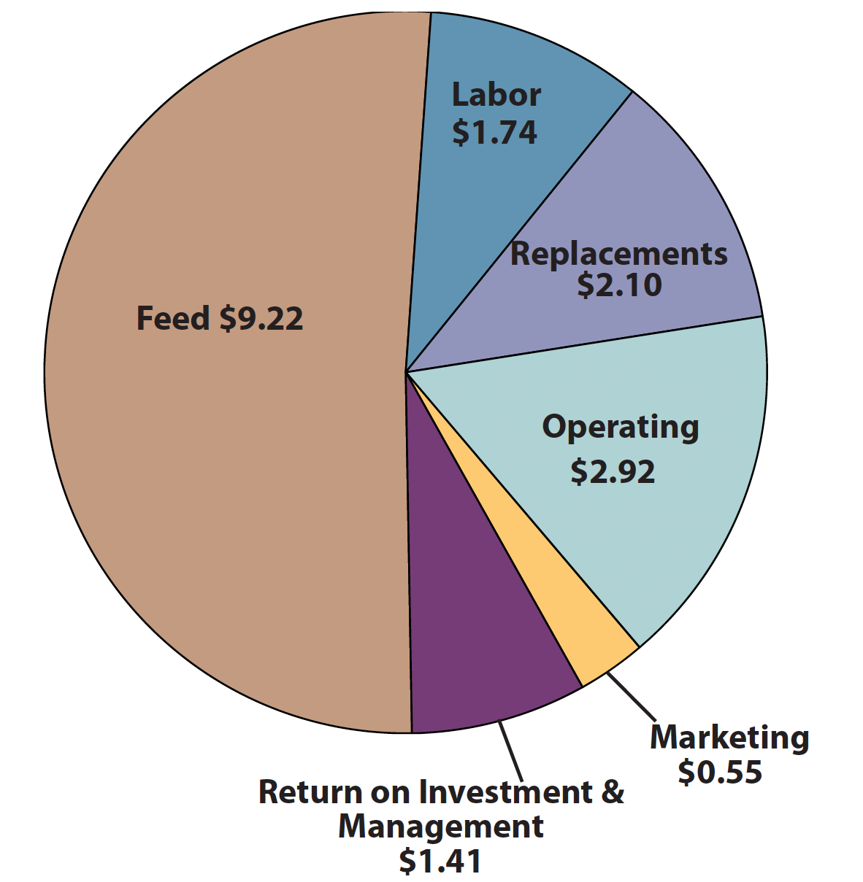
Cost Comparison Summary
(Cost per cwt)
California: Cost of Milk Production 2016 Annual
California Department of Food and Agriculture

Slide 11
Collect Data and Evaluate
Summarized data with evaluated (milk fat levels are low or 3.6% vs 3.8% Holstein breed average)
Consider frequency distributions (average manure score is 3.0 or 30% score 3, 40% score 3, and 30% score 4 for the high pen)
Photos can be useful (heifers are heavy)
Use research (based on U of WI, NRC-2001, and/or recommended by Mike Hutjens)

Slide 12
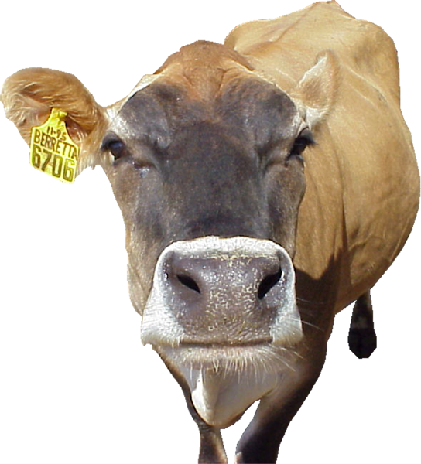
Feed Evaluation

Slide 13
Evaluating Rations
Nutrient profile (pounds or percent of MP, NDF, starch, DCAD….)
Dry cows vs. milk cows groups
Feed particle size
Forage quality and sources
Ingredient selection (palm oil, organic trace minerals, rumen protected, amino acids….)

Slide 14
Evaluating Feeding System
Evidence of sorting
Inches of feed bunk space per cow
Heat stress abatement
Feeding frequency
Pushing of feed
Feed weigh back (orts) and evaluation

Slide 15
Milk Fat and Milk Protein Relationship
(Hoard’s Dairyman—August 2018)
 | Fat % | Protein % | Protein vs Fat | Fat vs Protein
Ayrshire | 3.89 | 3.14 | 81% | 1.23
Brown Swiss | 4.05 | 3.32 | 82% | 1.22
Guernsey | 4.56 | 3.35 | 73% | 1.36
Holstein | 3.81 | 3.06 | 80% | 1.24
Jersey | 4.89 | 3.70 | 75% | 1.32

Slide 16
Pounds of Protein and Fat
Breed | RHA | Milk/Day | Fat | Protein | Total
Ayrshire | 18,886 | 50 | 1.97 | 1.61 | 3.6
Brown Swiss | 22,509 | 62 | 2.46 | 2.04 | 4.5
Guernsey | 16,229 | 45 | 2.02 | 1.47 | 3.5
Jersey | 19,278 | 53 | 2.55 | 1.92 | 4.5
Holstein | 25,476 | 70 | 2.61 | 2.24 | 4.9
 |  | 80 | 2.98 | 2.42 | 5.4
 |  | 90 | 3.36 | 2.72 | 6.1
 |  | 100 | 3.73 | 3.02 | 6.8

Slide 17
Forage Quality: NDFD--48 Summary
 | Average | Range
Mixed Hay | 47 | 32 - 62
Legume Hay | 46 | 32 - 61
Grass Hay | 55 | 38 - 73
Mixed Haylage | 42 | 25 - 60
Legume Haylage | 42 | 25 - 58
Grass Haylage | 61 | 51 - 72
Corn Silage | 60 | 48 - 71

Slide 18

Legume Haylage
 | 2018 | 5yr Avg
Moisture | 56.4% | 54.8%
CP | 20.6% | 20.9%
ADF | 33.8% | 34.3%
aNDF | 39.0% | 40.1%
aNDFom | 37.0% | 37.5%
Lignin | 7.71% | 7.94%
uNDFom240 | 17.2% | 17.6%
NDFD30 | 47.3% | 45.1%
WSC (sugar) | 4.28% | 4.13%
Ash | 11.3% | 11.4%
RFQ | 157.3 | 145.6
Count | 2,920 | 41,669

Slide 19
Corn Silage Fiber Values
 |  |  |  | Normal Range
 |  | Example | Average | Low | High
ADF | %DM | 24.68 | 24.66 | 17.06 | 32.26
aNDF |  | 38.85 | 41.00 | 30.08 | 51.92
aNDFom |  | 37.90 + | 40.10 | 29.71 | 50.76
NDFD30 | %NDF | 51.93 - | 53.87 | 43.57 | 64.17
NDFD120 |  | 61.58 | 71.54 | 62.62 | 80.34
NDFD240 |  | 65.83 | 73.90 | 65.70 | 83.20
uNDFom30 | %DM | 18.22 | 18.20 | 13.30 | 23.30
uNDFom120 |  | 14.56 - | 11.45 | 7.02 | 15.78
uNDFom240 |  | 12.95 - | 10.50 | 6.00 | 14.90

Slide 20
Feed Efficiency
  Feed Efficiency: Pounds of 3.5%fat corrected milk divided by pounds of DM consumed
High group, mature cows > 1.7
High group, 1st lactation > 1.6
Low group, all cows > 1.2
One group TMR herds > 1.5
Fresh cows (< 21 days) < 1.5
Concern < 1.3
Example: 75 pounds milk / 50 pounds DMI = 1.5
3.5% FCM = (0.4324 x lbs. of milk) + (16.216 x lbs of milk fat)

Slide 21
Milk Yield Targets (Ohio State University)
Milk Yield (lb) Feed efficiency
55 1.25
60 1.32
65 1.38
70 1.44
75 1.49
  80 1.54
85 1.58
90 1.63

Slide 22
Milk Yield Targets (Ohio State University)
Feed efficiency
Milk Yield (lb)

Slide 23
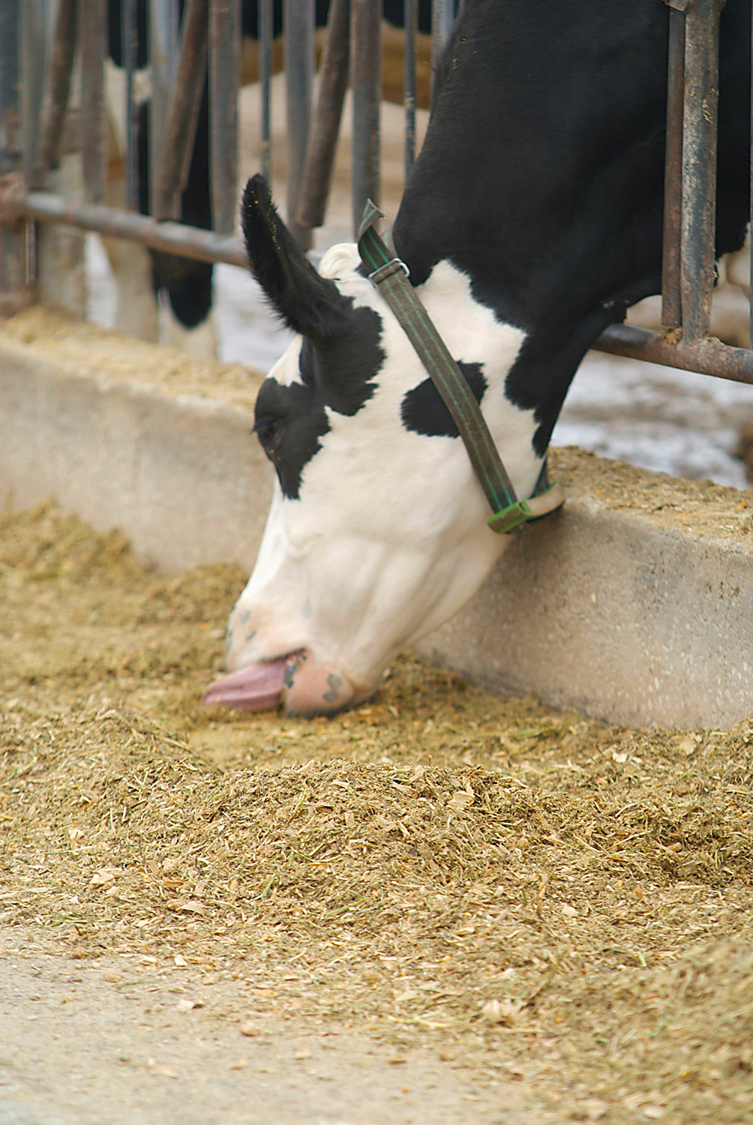
What is Shrink?
The quantity of feed fed that the cow doesn’t eat
Varies from 1 to > 20% of available feed
Cost 10 cents to 15 cents per cow per day

Slide 24
Shrink Areas of Focus
Forage management
Pre-blending concentrates
Weigh backs
Reducing feed variation
TMR mixing strategies (precision blending)
Storage (bags, vertical storage, etc)
Tracking inventory

Slide 25
Physically effective fiber
Providing 3 pounds of feed particles over ¾ inch or 19 cm (6% Penn State top box)
550 to 600 minutes of cud-chewing
(>450 minutes/cow on rumination collar)
50 to 75% of cows at rest should be cud-chewing
> 50 chews per bolus of feed.
Result: Rumen pH should be over 6.0 and
> 2.2 parts acetate : one part propionate

Slide 26
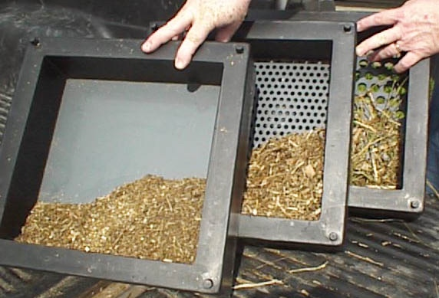

Slide 27
Penn State Separator (Illinois)
 | % (as fed)
 | Top | Middle | Bottom
TMR | < 5% | >50 | <50
Haylage | >20 | >60 | <25
Corn silage* | 5 to 15 | >50 | <35
* ³/₄ TLC-Process

Slide 28
Penn State Separator / PA
(3rd box at 4.0 mm)
 | % (as fed)
 | Top | 2nd | 3rd | Bottom
TMR | < 5 | > 50 | <30 | <20
Haylage | 10 to 20 | 40 to 75 | 20 to 30 | <5
Corn silage* | 3 to 8 | 40 to 60 | 30 to 40 | <5
* ³/₄ TLC-Process

Slide 29
Kernel Processing Score
∆Worth 2 lb. Milk
or 2 lb. Corn
Each change is
2 lbs. more milk
RD Shaver UW-Madison

Slide 30
Distribution of Fecal Starch in Dairy TMR
(CVAS, 2017)

Slide 31
Feed Bench Marks
Feed costs per day: limited value
Feed costs per kg of mil:
reflects milk yield, shrink, and feed costs
Feed costs per kg of dry matter:
reflect feed ingredients selection
Income over feed costs: reflects profit margin
Feed efficiency: evaluates feed conversion to milk yield

Slide 32
Feeding Economics 2019
Feed costs per cow per day $4.57
Feed cost per lb DM $0.09
Milk Production
80 lb 70 lb
Feed cost per cwt $ 5.71 $ 6.53
Income over feed costs ($16) $ 10.29 $ 9.47
Feed efficiency (lb milk/lb DM) 1.60 1.40

Slide 33
Total Cost to Raise a Dairy Replacement from Birth to Freshening

Slide 34
Raising Heifers is Not a Profit Center
Cost to raise heifers is >$2,000; current market prices between $1000 to $1200 for springing heifers
Number of heifers needed:
  Culling rate
  Death losses of heifers
  Calving interval
Tools:
  Genomics (find the best ones)
  Sex semen (get heifers from the best genetics)
  Beef crossbreeds
  (premium +$150, calving ease, and healthy of calves)

Slide 35
When Raising Replacement Heifers
Must feed an accelerated liquid diet
Textured calf starter at >18% crude protein
Heifers must calve at 23 months
Must measure rate of gain (>1.8 lbs. Holsteins)
Must have health records on respiratory and scour calves (cull candidates)

Slide 36
Reproduction
Evaluation

Slide 37
Reproduction Evaluation
Preg rate (over 25%)
Heat detection rate (>60)
Conception rate (> 40%)
Synchronization programs
Pregnancy loss (< 15%)
Sex semen use

Slide 38
Culling Evaluation
Genetic Evaluation
Labor Evaluation
Financial Evaluation
Milk Quality Evaluation
Heifer Evaluation
Lameness Evaluation

Slide 39
“Listening” To Your Herd
MUN levels 8 to 12 mg/dl
Milk protein test > 3.2% (Hol), 4.0% (Jersey)
Milk fat test >3.7% (Hol), > 4.6% (Jersey)
Management Level Milk Increasing
Fecal scores > 80% at 3
Lameness < 10% at 3

