Slide 1
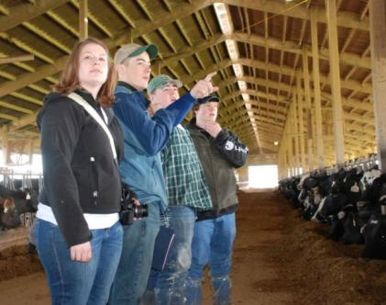
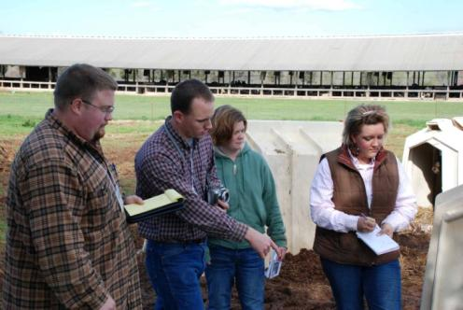
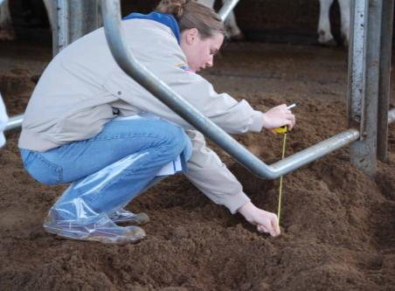
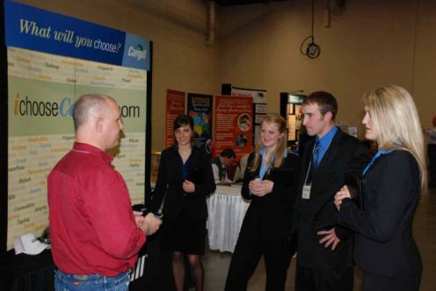
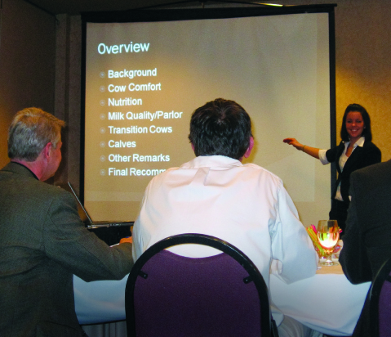
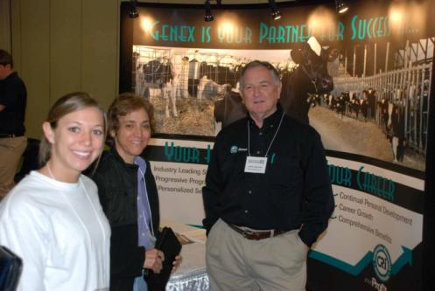

Slide 2
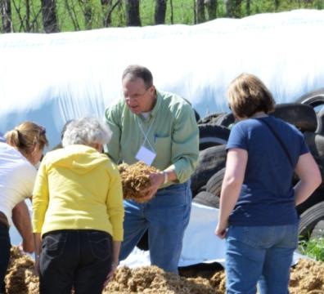
Dairy Challenge
Started in 2002
Cooperation of
Dairy producers
Dairy companies
Universities/professors
Has grown to:
600 college students each year
55 universities & technical schools
Notes:
First Dairy Challenge contest was in 2002 with 13 universities and 56 students.
10 years later, the 2012 national contest had 32 universities and 128 students. Today, we host more than 250 students at our national contest.

Slide 3
4 Regional Dairy Challenges
MIDWEST
Freeport, IL
Feb. 13-15, 2019
NORTHEAST
Rochester, NY
Oct. 17-19, 2019
WESTERN
Ogden, UT
Feb. 21-23 2019
*
*
*
SOUTHERN
Campbellsville, KY
Nov. 17-19, 2019
*
Notes:
A perk of Dairy Challenge is getting to visit dairies around the US and seeing differences and similarities of dairy industry around the US.
There are 4 regional Dairy Challenge events. Each one moves to a different area/host school each year. 2019 locations are marked here.

Slide 4
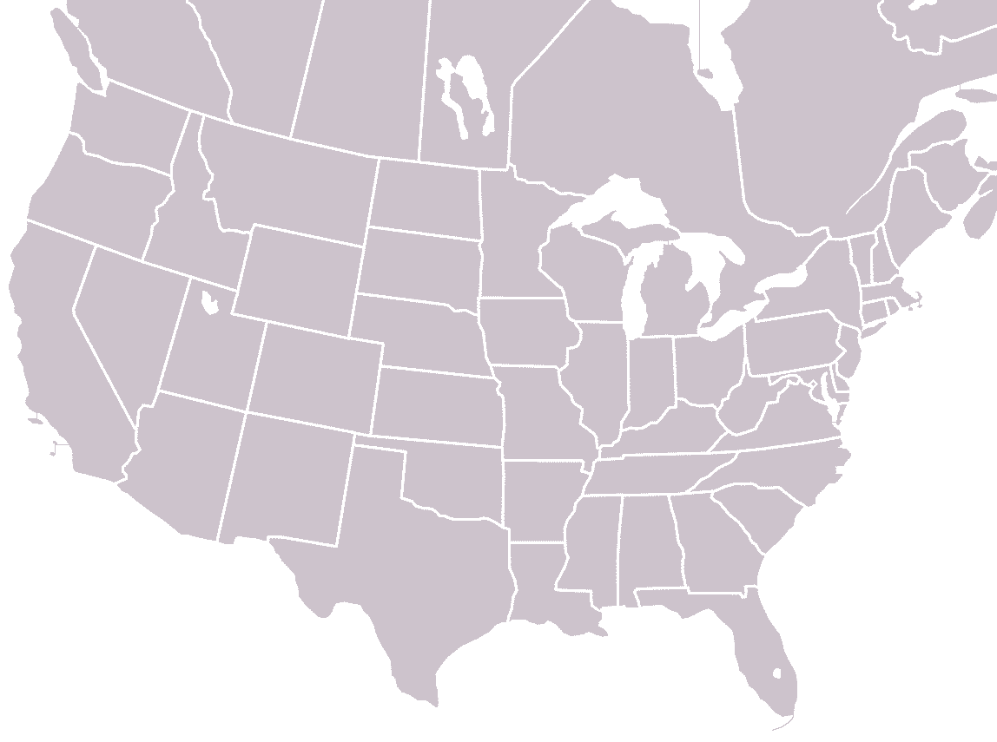
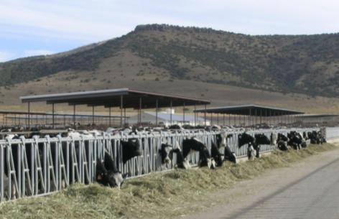
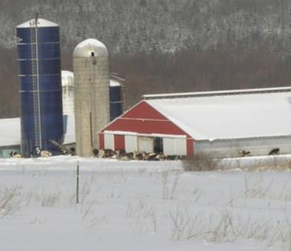
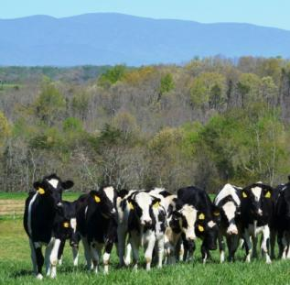
North American Contests
‘06
’02 ‘03
’09,’15-’16
‘07
‘08
‘13-14
’04-’05
’10, ‘17-’18
2019 National
Tifton, GA
March 28-30, 2019
‘12
‘11
Notes:
The North American contest also moves around, exposing students to dairy in different areas of U.S.
A handful of Canadian universities also participate.

Slide 5
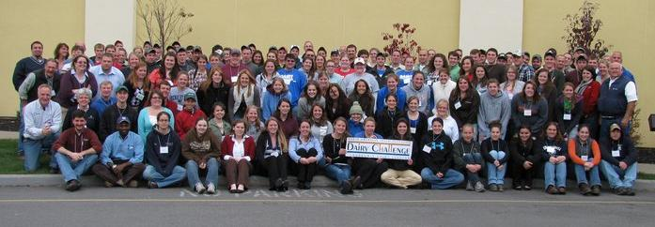
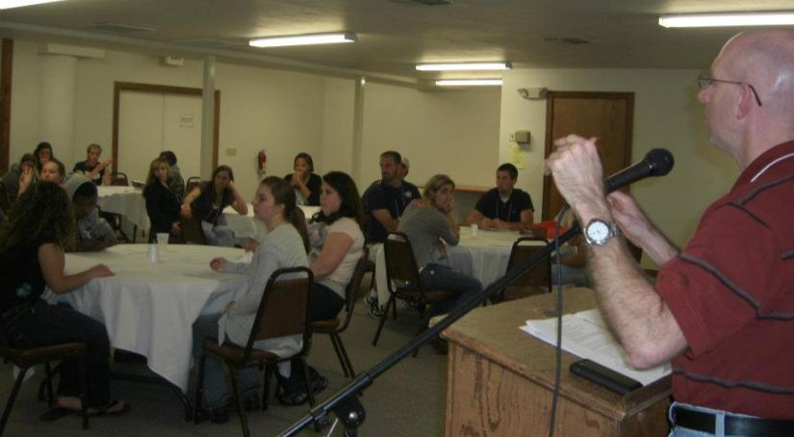
Day 1: Welcome

Slide 6
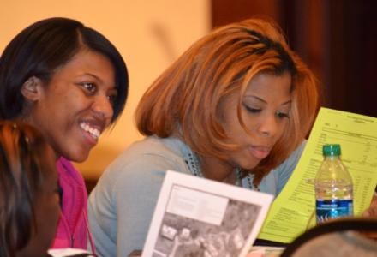
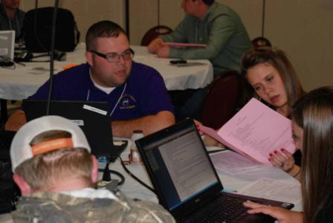
Day 1: Analyze Farm Data

Slide 7
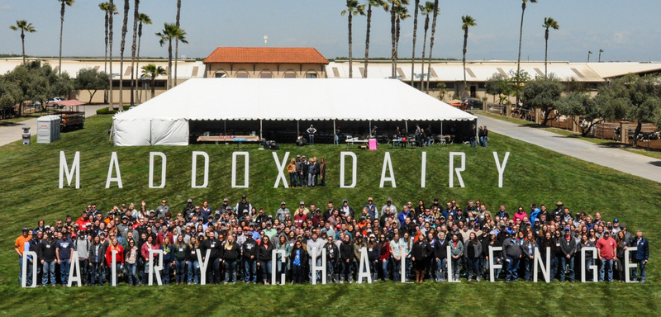
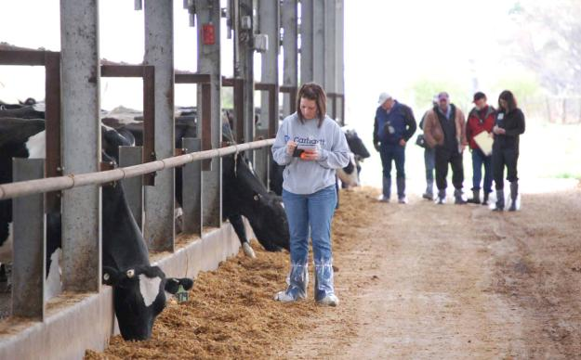
Day 2: Visit Farm

Slide 8
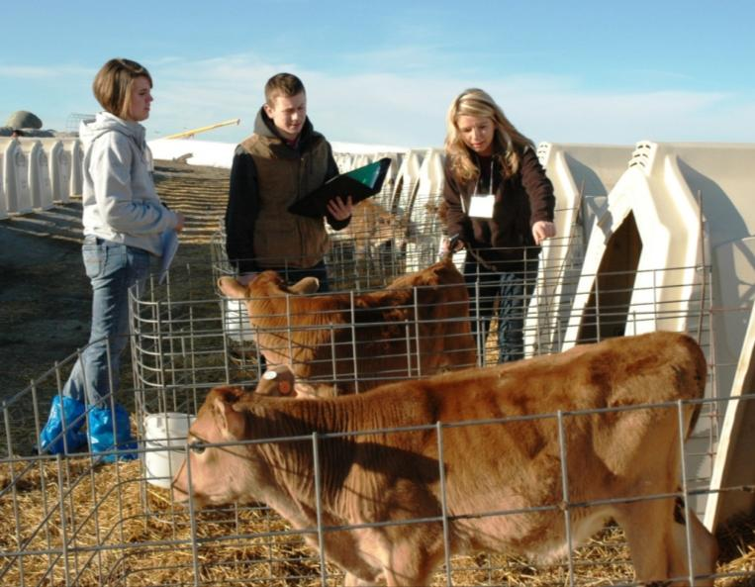
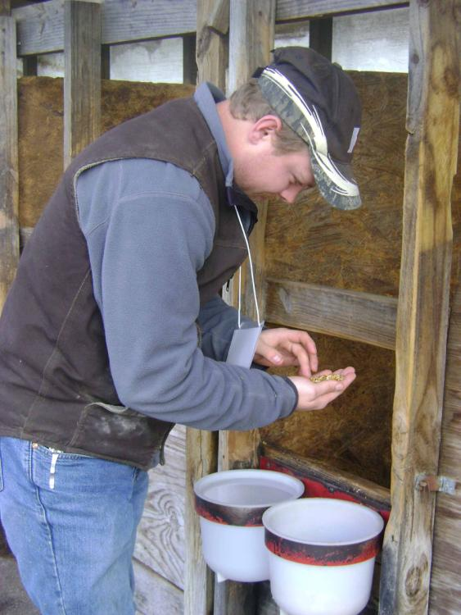
Calf Care

Slide 9
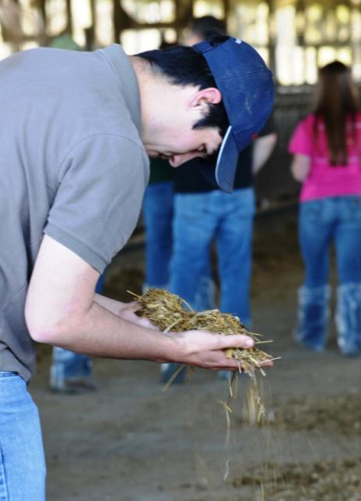
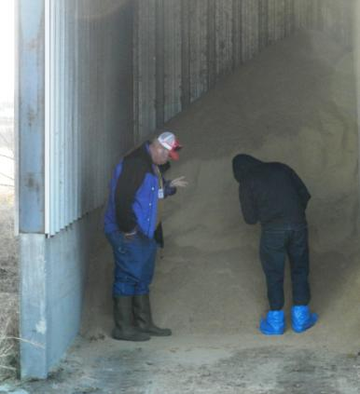
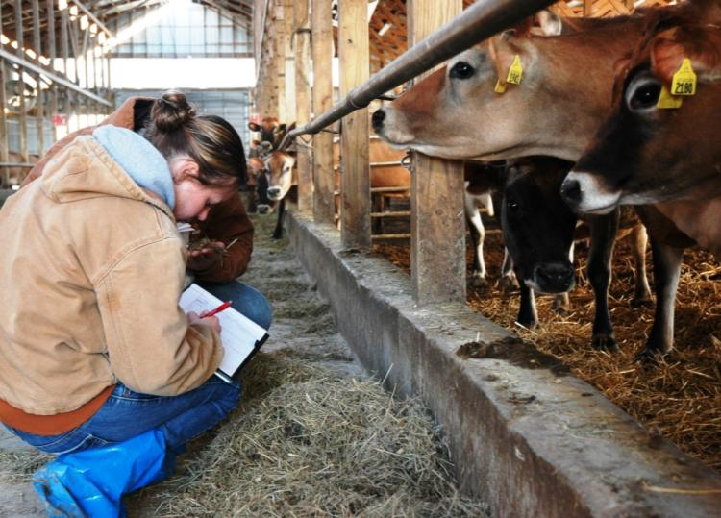
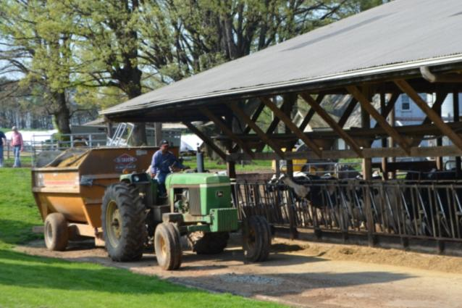
Feeding

Slide 10
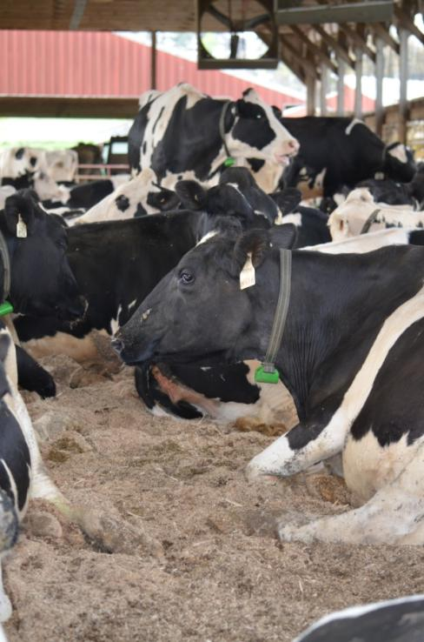
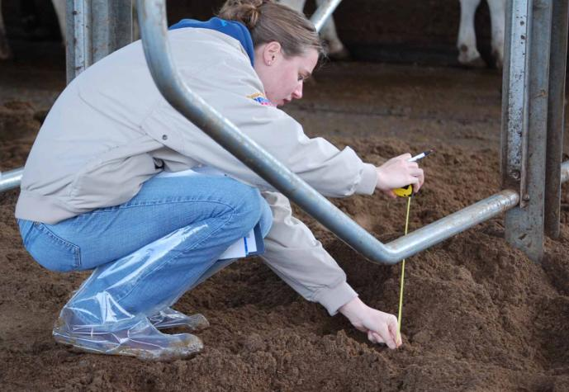
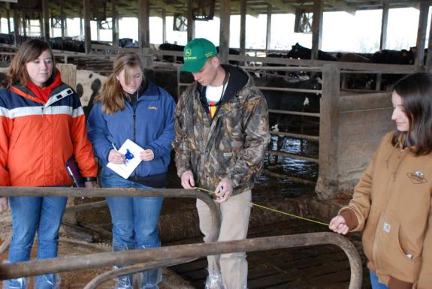
Cow Comfort

Slide 11
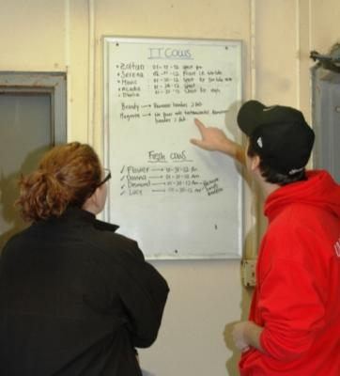
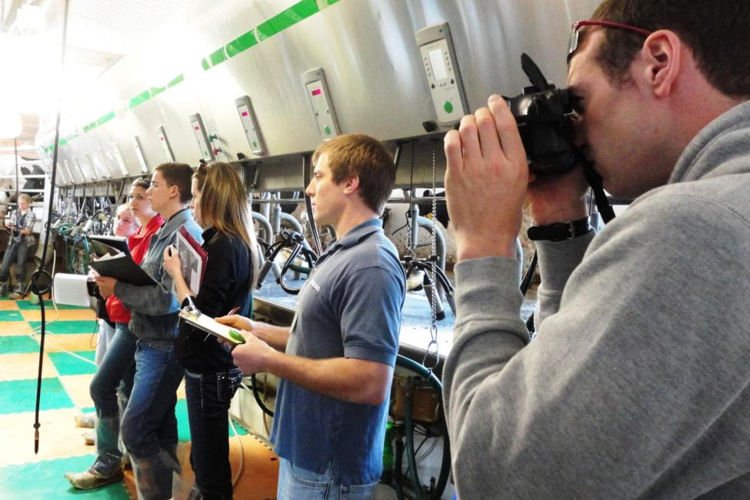
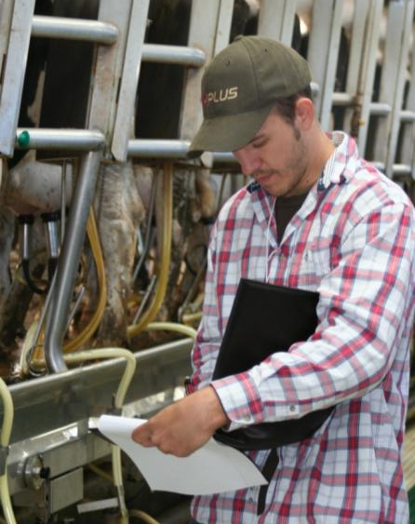
Milking Procedure

Slide 12
Manure Management

Slide 13
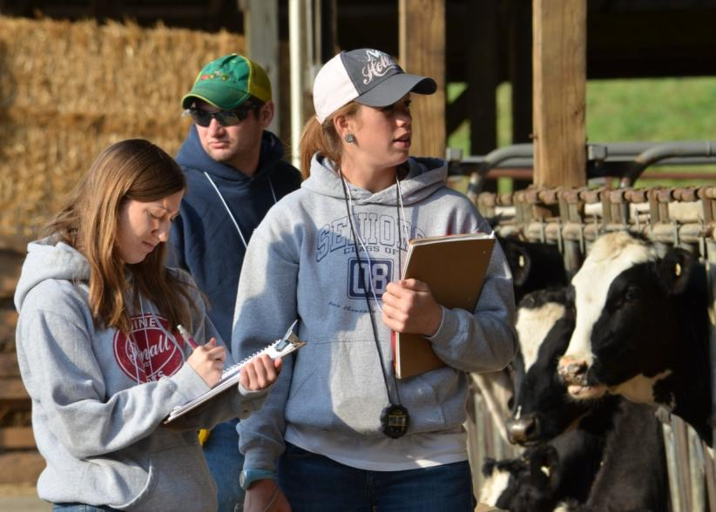
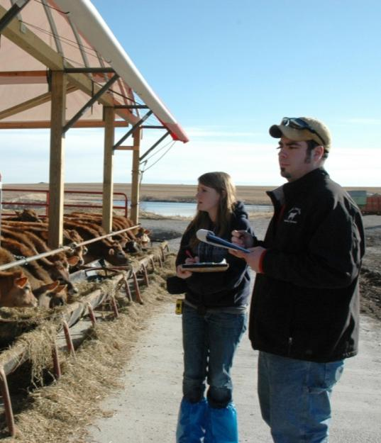
Detailed Notes

Slide 14
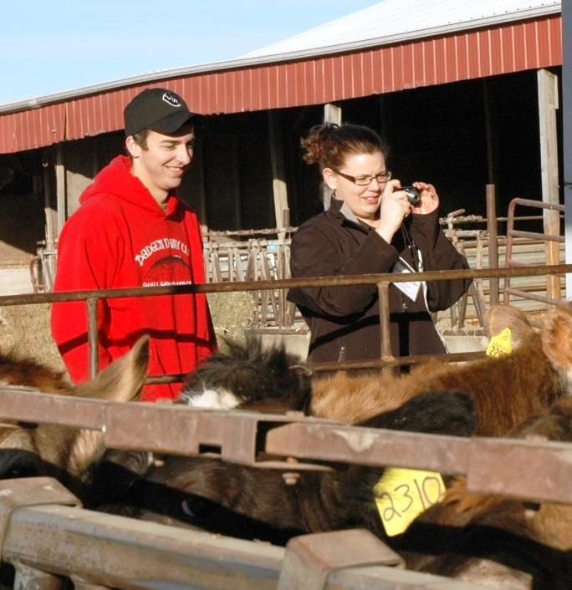
Photos for Presentation

Slide 15
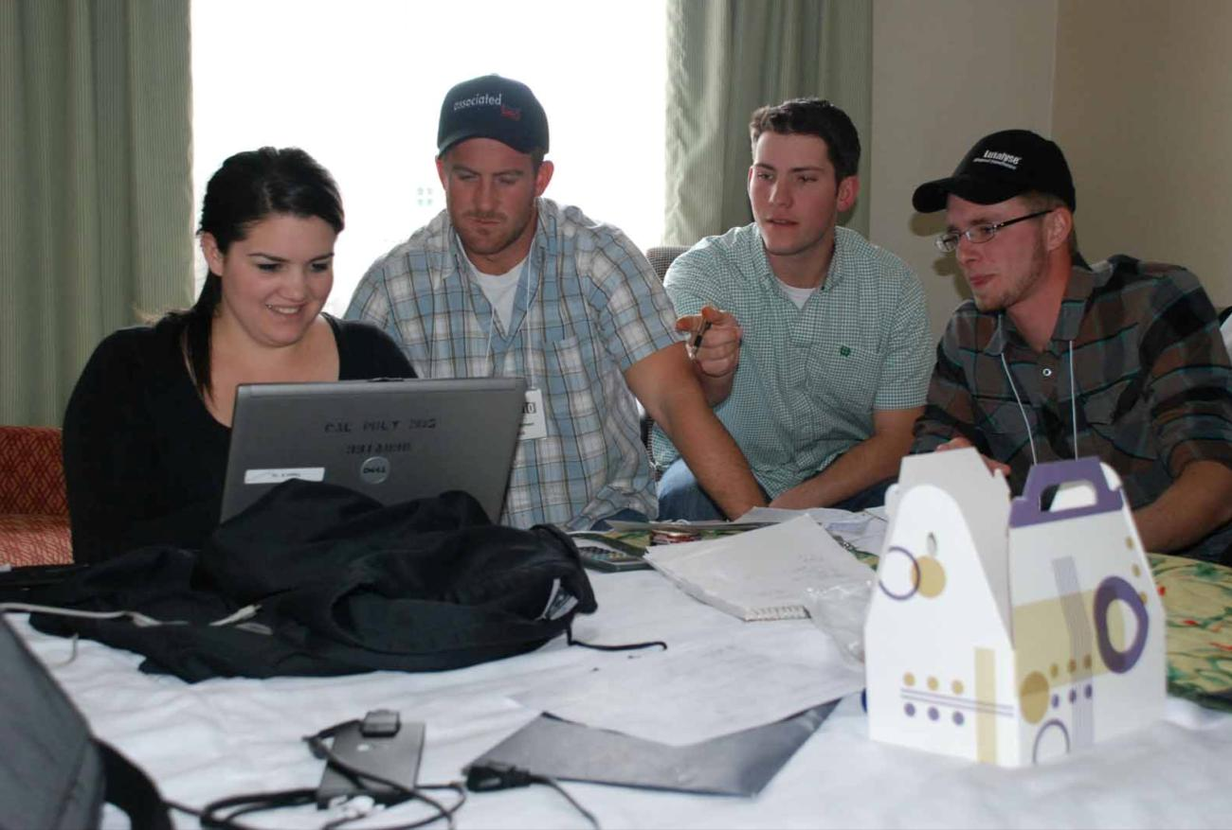
Day 2: Prepare Report

Slide 16
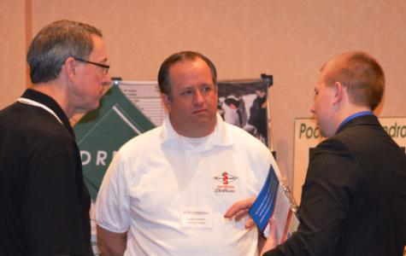
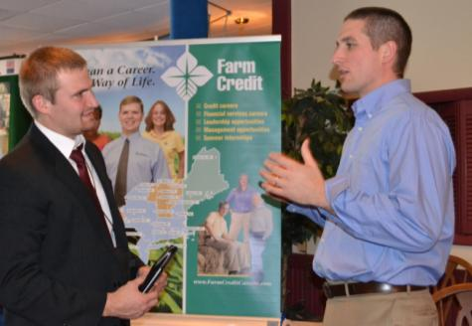
Day 3: Innovation Fair

Slide 17
Day 3: Present to Judges

Slide 18
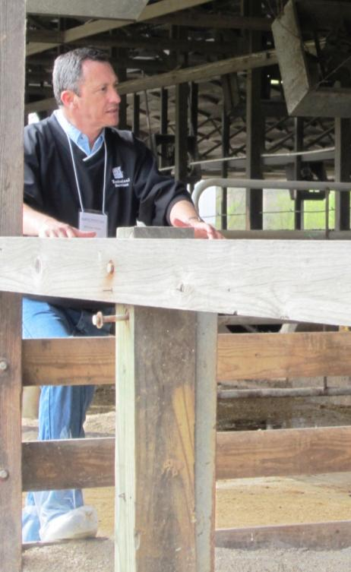
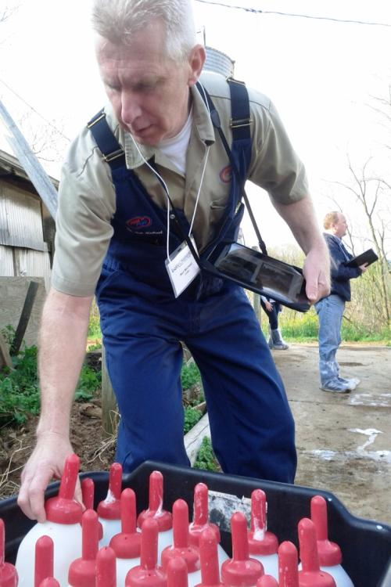
Same Data, Tour for Judges

Slide 19
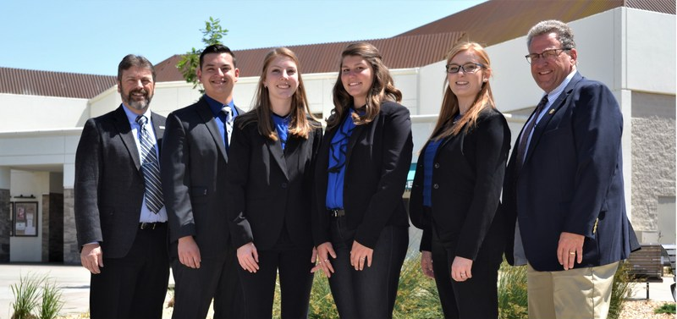
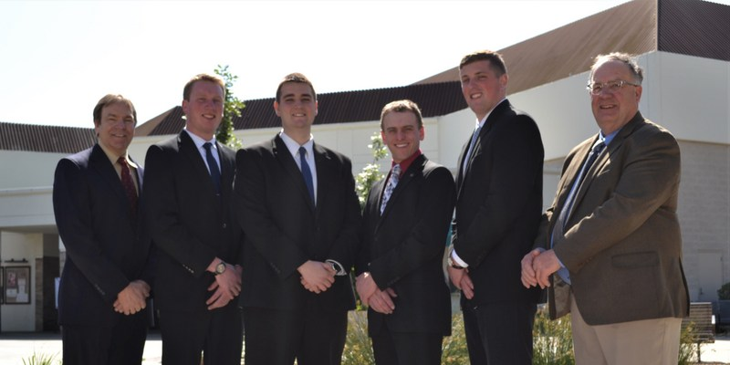
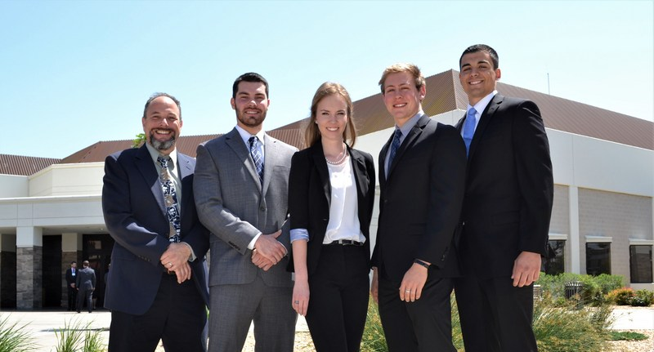
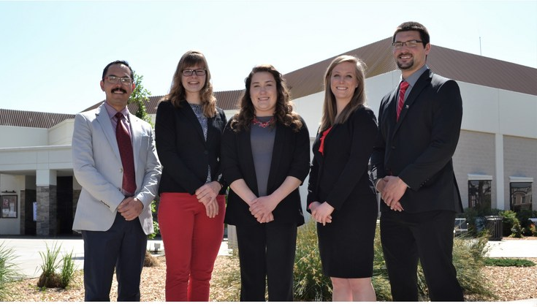
Four 1st Place Awards at National
2018 Winners: Michigan State University, University of Wisconsin-Madison, Cal Poly, Iowa State University

Slide 20
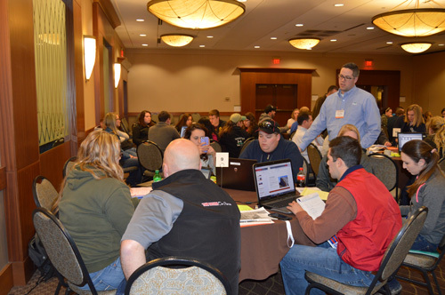
Dairy Challenge Academy
Started in 2013 to reach more students
Includes sophomores, juniors and seniors
Offered to four-year dairy programs, community colleges and tech schools

Slide 21
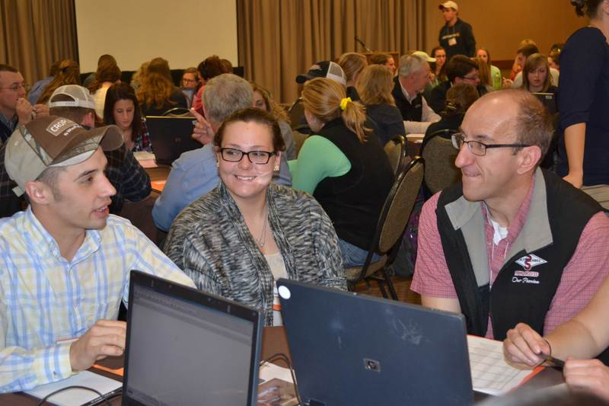
Dairy Challenge Academy
Objectives:
Offer dairy education and networking to as many as 200 students
Further engage university and industry professionals in teaching contemporary dairy issues
To date nearly 700 students have attended

Slide 22
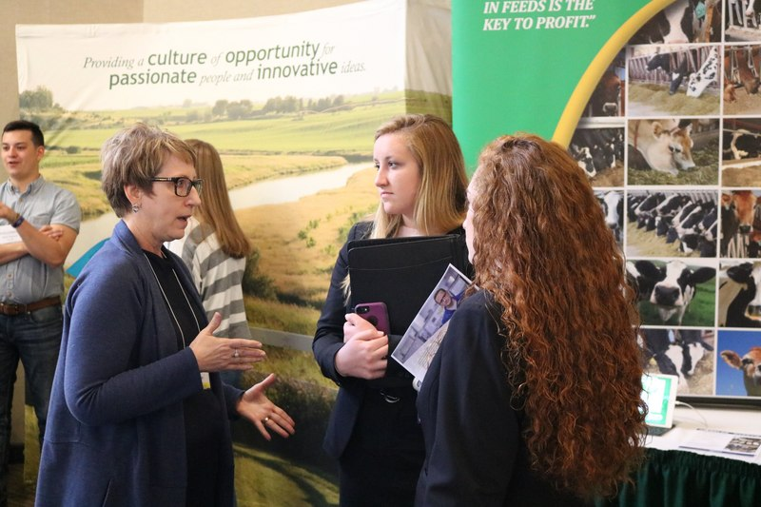
Join us !
Become a sponsor
Register to volunteer
Join our career fair

Slide 23
For more information
www.dairychallenge.org
www.facebook.com/DairyChallenge
@DairyChallenge
www.youtube.com/NAIDCDairyChallenge

